Slide 1
DATA VISUALIZATION
21/04/2022

Slide 2
Introduction
In this chapter we discuss techniques for the visualization of lists and tables of data that does not generally have an explicit spatial attribute.
(Spatial Attributes are an integral part of representation, which take advantage of the power of GIS to determine locational properties of Heritage data.)
We organize the presentations based on the graphical primitive used in the rendering, namely points, lines, or regions, followed by techniques that combine two or more of these types of primitives.

Slide 3
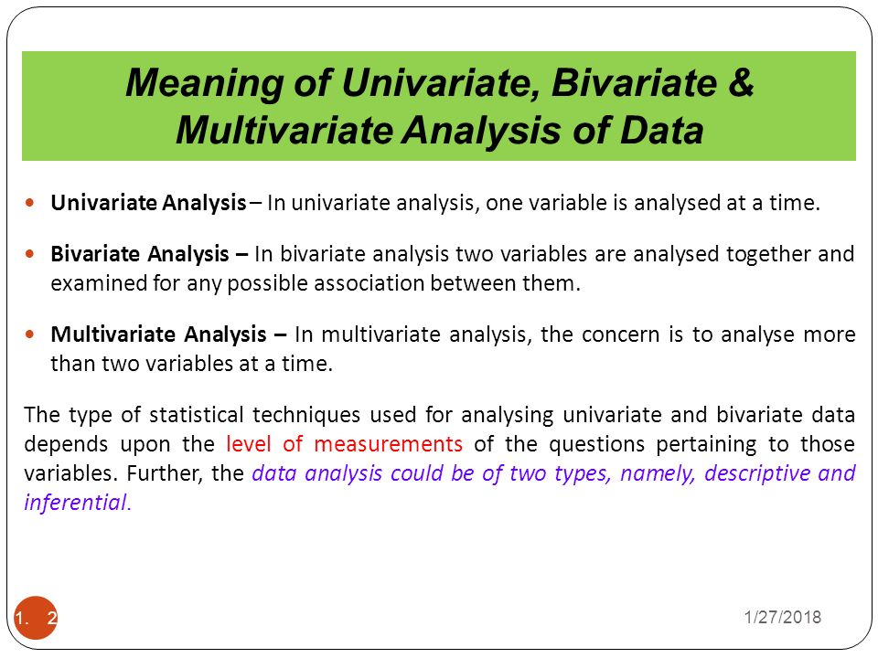

Slide 4
POINT BASED VASUALIZATION TECHNIQUES
Point plots can be defined to display individual records or summary records, and can be structured by various projection techniques.
Point plots are introduced as visualizations that project records from an n-dimensional data space to an arbitrary k-dimensional display space, such that data records map to k-dimensional points.

Slide 5
SCATTERPLOT AND SCATTER MATRICES
Scatterplots are one of the earliest and most widely used visualization techniques used in data analysis. Both 2D and 3D scatterplots can be found in most packages designed to support data and information analysis.
As the dimensionality of the data increases, the choices for visual analysis consist of
Dimension sub setting
Dimension reduction
Dimension embedding
Multiple Displays

Slide 6
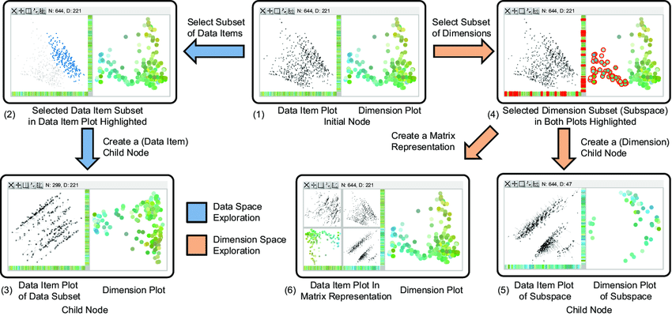
Dimension Sub setting
Dimension sub setting—allowing the user to select a subset of the dimensions to display, or to develop algorithms to find the dimensions containing the most useful information for the task at hand.

Slide 7
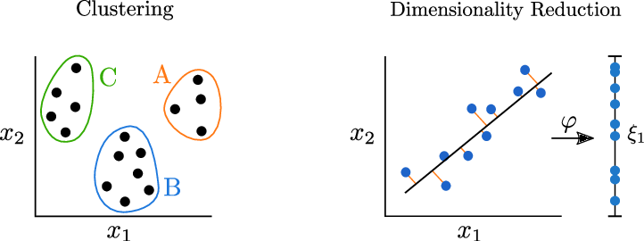
Dimensionality Reduction
Dimension reduction—using techniques such as principal component analysis or multidimensional scaling to transform the high-dimensional data to data of lower dimension, while attempting to preserve as best as possible the relationships among the data points.

Slide 8
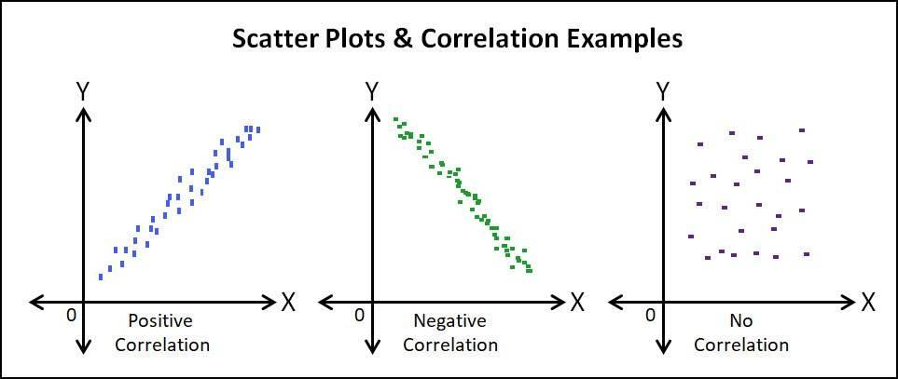
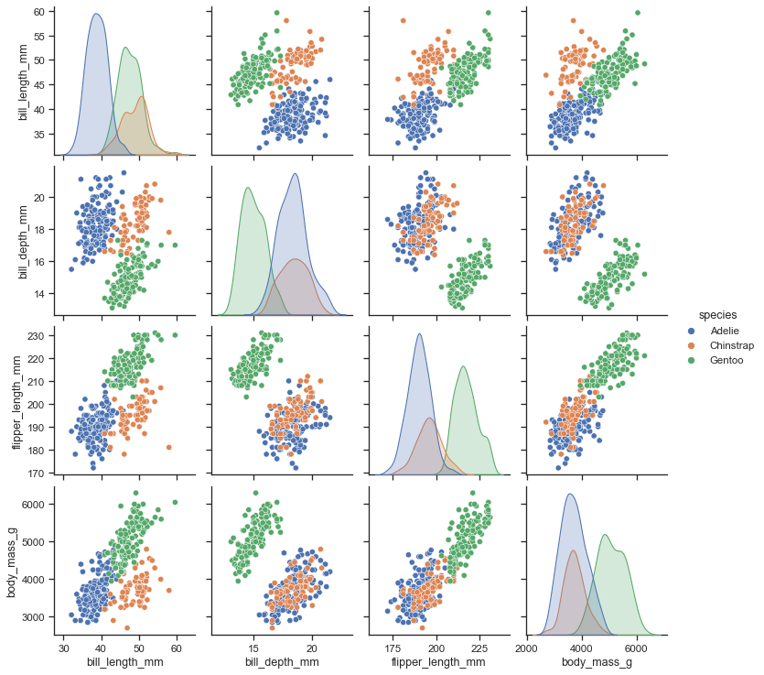
SCATTERPLOT AND SCATTERPLOT MATRIX

Slide 9
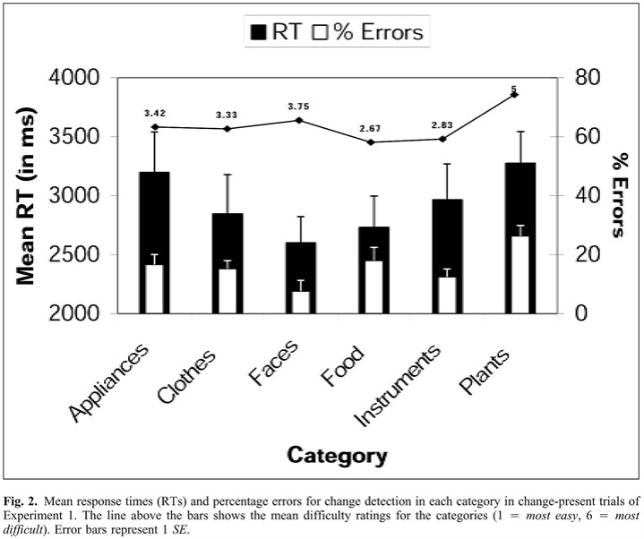
Dimension Embedding & Multiple Display
Dimension embedding—mapping dimensions to other graphical attributes besides position, such as colour, size, and shape (though there are limits to how many dimensions can be included this way).
Multiple displays—showing, either superimposed or juxtaposed, several plots, each of which contains some of the dimensions.

Slide 10
MULTI DIMENSIONAL SCALING (MDS)
Multidimensional scaling is a means of visualizing the level of similarity of individual cases of a dataset.
From a non-technical point of view, the purpose of multidimensional scaling (MDS) is to provide a visual representation of the pattern of proximities (i.e., similarities or distances) among a set of objects.
For example, given a matrix of perceived similarities between various brands of air fresheners, MDS plots the brands on a map such that those brands that are perceived to be very similar to each other are placed near each other on the map, and those brands that are perceived to be very different from each other are placed far away from each other on the map.

Slide 11
FORCE BASED METHODS
Any techniques for projecting high-dimensional points into 2D or 3D display space have been developed.
The key goal is to attempt to maintain the N-dimensional features and characteristics of the data through the projection process, e.g., relationships that exist in the original data must also exist after projection.
This, however, is not always possible, especially as the dimensionality of the data increases. The projection may also unintentionally introduce arti facts that may appear in the visualization and are not present in the data

Slide 12
ALGORITHM
Given a data set with M records and N dimensions, create an M by M matrix Ds that contains similarity measures between each pair of data items.
Assuming that you are projecting the data into K dimensions (e.g., for display purposes, K is usually between 1 and 3), create an M by K matrix L to contain the locations for the projected points. These M locations can be randomly chosen, or techniques such as principal component analysis (PCA) can be used to create reasonable initial positions.

Slide 13
CONTD
3.Compute an M by M matrix Ls that contains the similarities between all pairs of points in L.
4. Compute the value of stress, S, which is a measure of the differences between Ds and Ls. Many such stress measures exist; most assume that the coordinate systems have been normalized so that the maximum distance between points is 1.0.
5. If S is sufficiently small, or hasn’t changed significantly in recent iterations, the algorithm terminates.
6. Otherwise, attempt to shift the positions of points in L in a direction that will reduce their individual stress levels. For example, this might be a weighted sum of displacements based on comparing the point with all other points, or perhaps only with its nearest neighbours. The displacement should be scaled such that points don’t oscillate between positions.

Slide 14
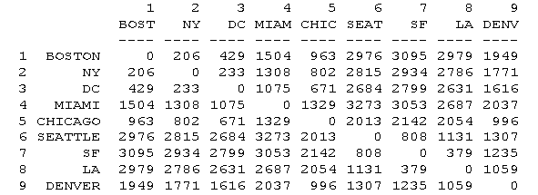
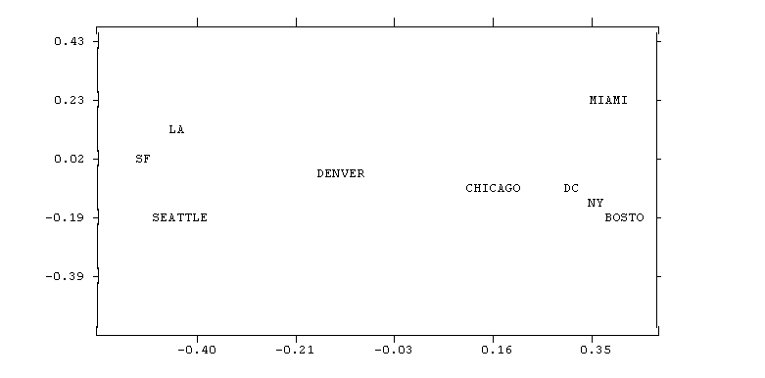
For instance, given the matrix of distances among cities shown above, MDS produces this map:
In this example, the relationship between input proximities and distances among points on the map is positive: the smaller the input proximity, the closer (smaller) the distance between points, and vice versa.
Had the input data been similarities, the relationship would have been negative: the smaller the input similarity between items, the farther apart in the picture they would be.

Slide 15
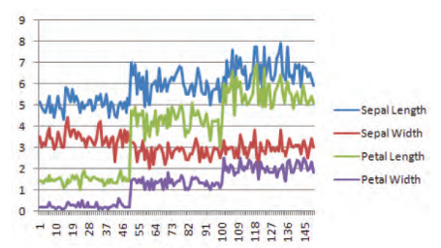
Line based Techniques
Point-based methods represent each data value or record with a small mark. In line-based methods, points corresponding to a particular record or dimension are linked together with straight or curved lines.
These lines not only reinforce the relationships among the data values, but also convey perceivable features of the data via slopes, curvature, crossings, and other line patterns.

Slide 16
Line Graph
A line graph is a univariate visualization technique where the vertical axis represents the range of values for the variable and the horizontal axis represents some ordering of the records in the data set.
Most univariate visualization techniques can be extended to multivariate data by either superimposing or juxtaposing the visual representations of individual variables.
A commonly used method of this sort is via line graphs.

Slide 17
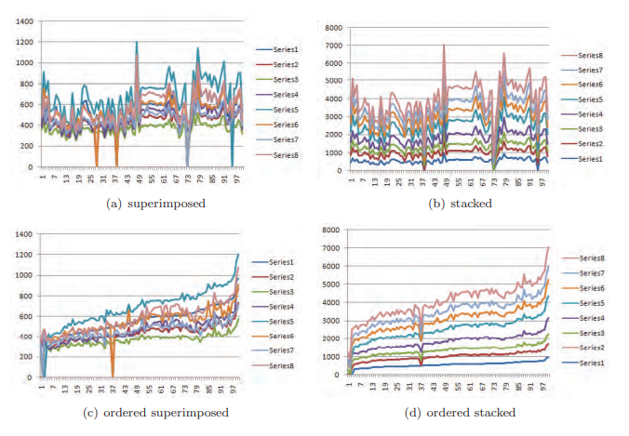
Contd.
The effectiveness of the examples above is due in large part to the fact that common units exist between the dimensions (e.g., size in one and dollars in the others). When variables have different units, things get a bit more complex

Slide 18
Parallel Coordinates
Parallel coordinates, also called ||-coords and PCP (for parallel coordinates plot), were first introduced by Inselberg in 1985 as a mechanism for studying high-dimensional geometry.
Since then, numerous researchers, including Inselberg, have studied and enhanced PCPs for use in multivariate data analysis.
The basic idea is that axes, rather than being orthogonal, are parallel, with evenly spaced vertical or horizontal lines representing a particular ordering of the dimensions.
A data point is plotted as a polyline that crosses each axis at a position proportional to its value for that dimension.

Slide 19
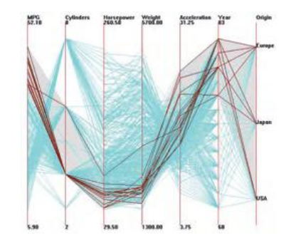
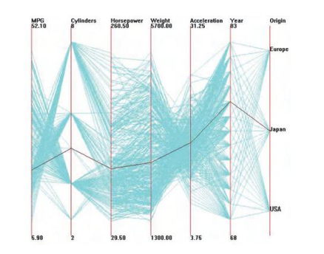
CONTD.
An example of a 7-dimensional data set visualized with parallel coordinates. A single data point is represented as the darkened polyline

Slide 20
Capabilities of Parallel Coordinates
Many researchers have extended the capabilities of parallel coordinates over the years. Some of these include:
• hierarchical parallel coordinates that show data clusters rather than the original data;
• using semi-transparent lines to reveal clusters in large data sets;
• clustering, reordering, and spacing of axes based on correlation;
• reordering axes to reduce visual clutter;
• grouping data into cluster bands with special treatment of outliers;
• Incorporating histograms into the axes to better convey univariate distributions;
• fitting curves to the intersection points to better convey continuity across axes

